Slide 1
SAFE™ Forum 2025 U.S.
EXHIBITION KIT

Slide 2
Overview
Event Information
Agenda
Requirement Deadline
Set Up & Preparation Time
Floorplan & Registration
Booth Details
FAQ
Contact Info
Contents

Slide 3
OVERVIEW

Slide 4
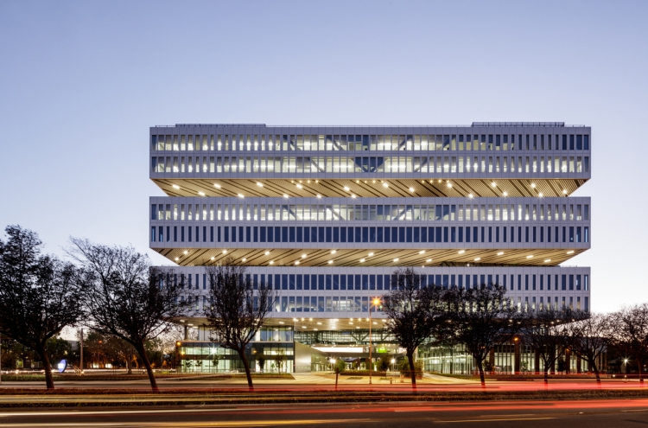
OVERVIEW
SAFE™ Forum 2025 U.S.
- Date : June 3, 2025 (10:00 - 5:20 PM)
- Venue : Samsung Semiconductor US Campus, San Jose
(3655 N. First St., San Jose, CA 95134)
- Contact: info@samsungfoundryevent.com

Slide 5
Event Information

Slide 6
Event Information
Agenda (SAFE™ Forum)
- Attendees will visit booth during the blue-colored time slot.
Time |  | Agenda
10:00 - 11:00 AM | 60’ | Registration, Partner Pavilion & Networking
11:00 - 11:15 AM | 15’ | Welcoming Remarks
11:15 - 11:35 AM | 20’ | Guest Speech Ⅰ
11:35 - 11:55 AM | 20’ | Guest Speech Ⅱ
11:55 AM - 12:15 PM | 20’ | Guest Speech Ⅲ
12:15 - 1:15 PM | 60’ | Lunch Partner Pavilion & Networking
1:15 - 3:15 PM | 120’ | Tech Session Ⅰ Design Solutions for Smarter Silicon | Tech Session Ⅱ Design Enablement for Smarter Silicon
3:15 - 3:20 PM | 5’ | Closing | Closing
3:20 - 5:20 PM | 120’ | Partner Pavilion & Networking
The program may be subject to change.
Please remain your booth occupied during that time.

Slide 7
Event Information
Requirement Deadline
- Submit the booth materials and logo by May 9th to partner portal. Partner Portal URL: https://samsungfoundryevent.atlassian.net/servicedesk/customer/portals
Logo should be . AI, . PSD (higher than CS4) format , CMYK type
Alternative . JPG (higher than 5000x2000px, 140dpi) format
Set up / Preparation Time
- Set up / Preparation / Maintenance
June 3rd, 8:00 - 9:30 AM PDT
- Clean-up
June 3rd, 5:20 - 7:00 PM PDT
We recommend to bring backup files on flash drive (USB) or laptop on the day of event.
All partner booths must be ready by 9:30 AM. Set-up and clean-up should be done according to schedules.

Slide 8
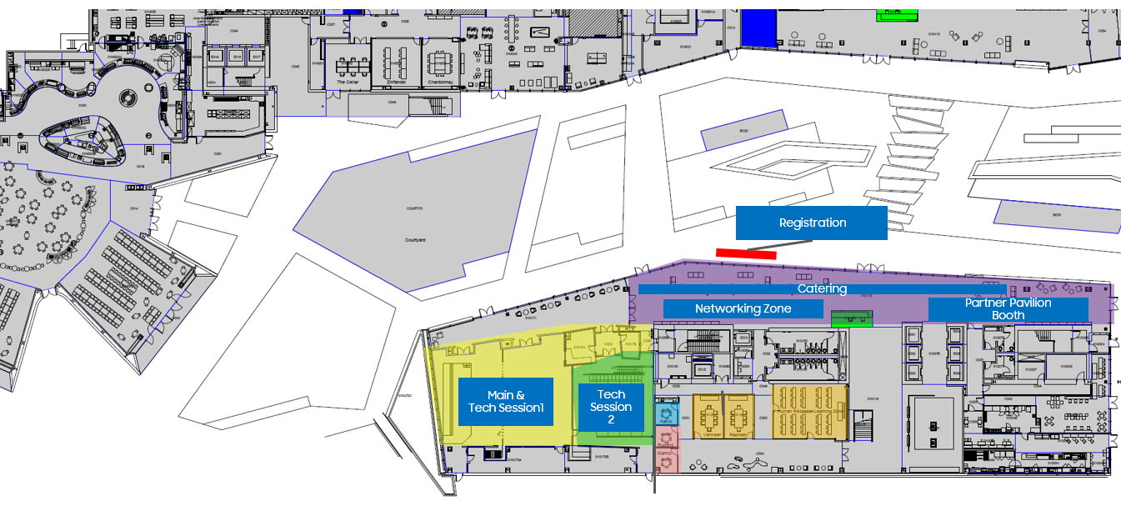
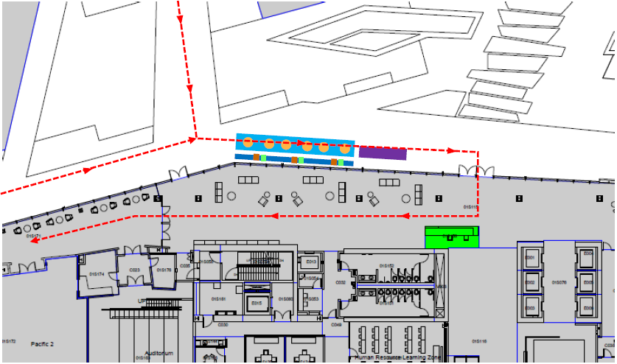
Event Information
Floor Plan & Registration
Registration opens at 10:00 AM PDT.
Please visit Info desk on the left side of the entrance. We will provide you with a name badge.
Registration
Info Desk
Speaker’s Room
< Floor Plan >
< Registration >

Slide 9
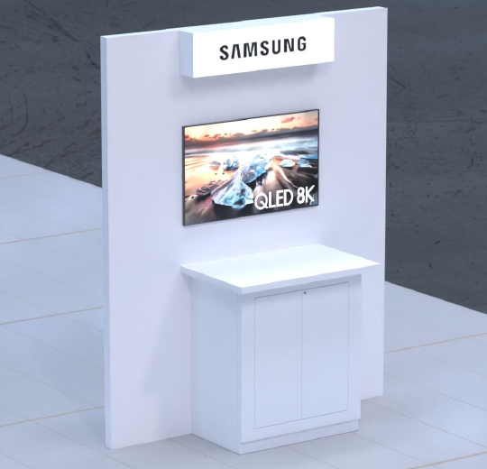
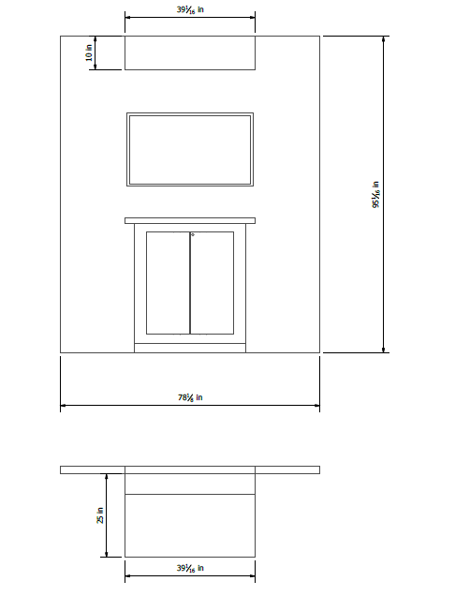
Event Information
Booth Details
Provided booth equipment | Detail | What you need to bring
Partner Booth | W1984mm x L635mm H:2414mm * Table : W992mm x L635mm | 1. Laptop 2. Adapters or dongle for your laptop 3. USB drive with backup presentation 4. Giveaway in your booth (optional)
LCD TV | 43inch HDMI supported Video can be displayed from USB drive.
Power Strip
Please bring your own laptop and mouse to connect to the monitor.
Please check if your laptop supports HDMI connection.
Please bring any adapters or dongle your laptop computer may need.
- Booth Design & Item

Slide 10
Event Information
FAQ
Q : Parking availability
Available.
Q : Wireless Internet availability
Available. But public Wi-Fi may be slow, a portable hotspot is recommended.
Q : Can I accompany my colleagues?
The booth must remain occupied by at least one member of your team at all times from 10:00am – 5:20pm.
Q : Can I select the booth position?
Sorry, the booth will be positioned in advance.

Slide 11
Event Information
Contact Info
Taeil Kim
ti1207.kim@samsung.com
Hanna Yang
hanna.yang@samsung.com
Don Kim
eastsky.kim@samsung.com
Lydia Chung
lydia.chung@samsung.com

Slide 12
Thank You

