Slide 1
SAFE™ Forum 2025 U.S.
Speaker Guide – Tech Session

Slide 2
I. Information
II. Tech Session
Rehearsal
Contact Info
Contents

Slide 3
Information

Slide 4
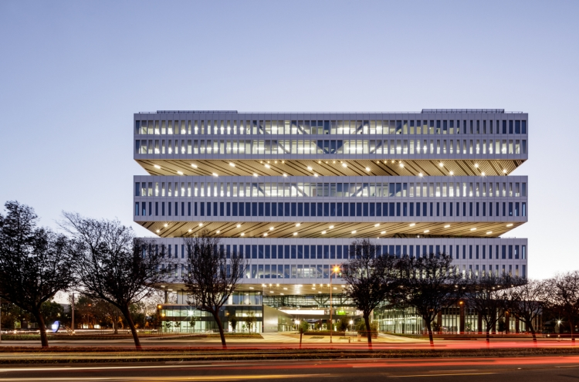
Information
SAFE™ Forum 2025 U.S.
- Date: June 3 2025 (10:00 AM - 5:20 PM)
- Venue: Samsung Semiconductor US Campus, San Jose
(3655 N. First St., San Jose, CA 95134)
- Contact: info@samsungfoundryevent.com

Slide 5
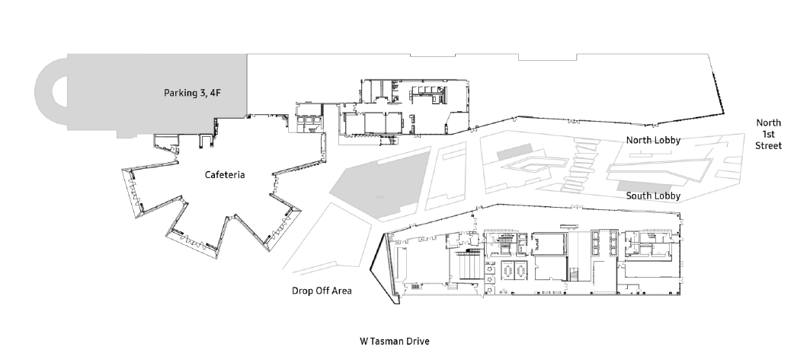
Information
Parking Information
Parking garage (3rd and 4th floors) at Samsung Semiconductor U.S. Campus (3655 N. First St., San Jose, CA 95134)
Parking - Floors 3 & 4
Tech
Session I
Tech
Session II

Slide 6
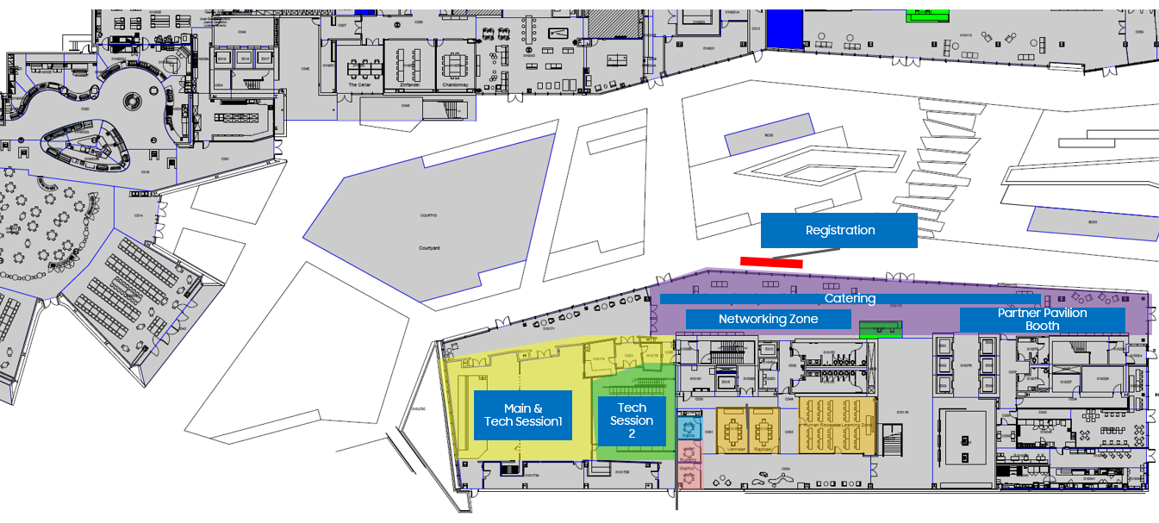
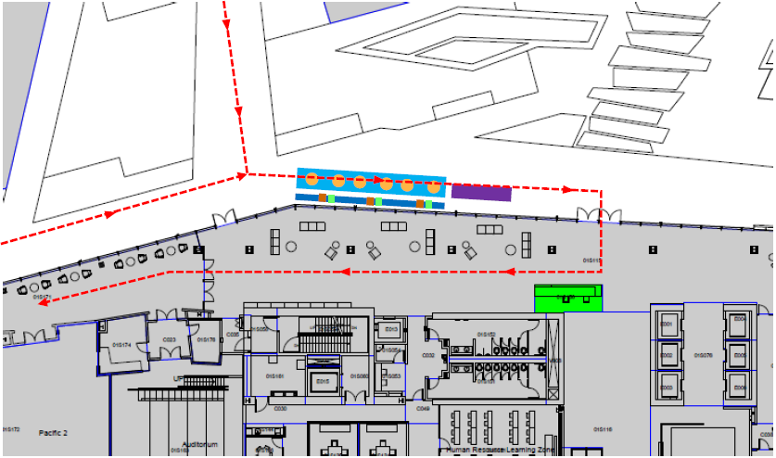
Information
Floor Plan & Registration
Registration opens at 10:00 AM PDT
Please visit the Info desk located outside the South Building. We will provide you with a name badge.
The staff will escort you to the waiting room.
Registration
Info Desk
Speaker’s Room
< Floor Plan >
< Registration >

Slide 7
Information
Agenda (SAFE™ Forum)
Time (PDT) |  | Agenda
10:00 - 11:00 AM | 60’ | Registration, Partner Pavilion & Networking
11:00 - 11:15 AM | 15’ | Welcoming Remarks
11:15 - 11:35 AM | 20’ | Guest Speech Ⅰ
11:35 - 11:55 AM | 20’ | Guest Speech Ⅱ
11:55 AM - 12:15 PM | 20’ | Guest Speech Ⅲ
12:15 - 1:15 PM | 60’ | Lunch Partner Pavilion & Networking
1:15 - 3:15 PM | 120’ | Tech Session Ⅰ Design Solutions for Silicon Intelligence | Tech Session Ⅱ Design Enablement for Silicon Intelligence
3:15 - 3:20 PM | 5’ | Closing | Closing
3:20 - 5:20 PM | 120’ | Partner Pavilion & Networking
The program may be subject to change

Slide 8
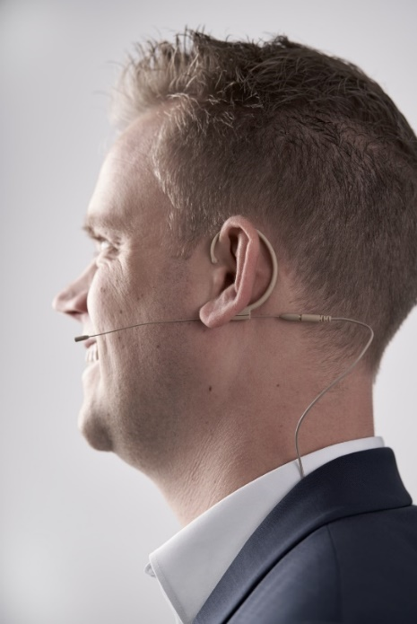
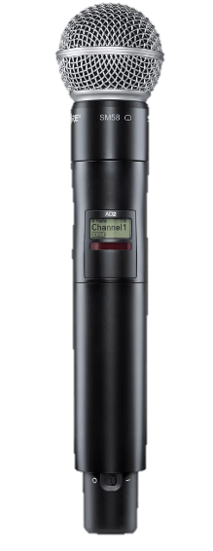

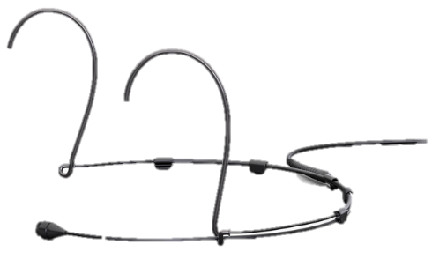
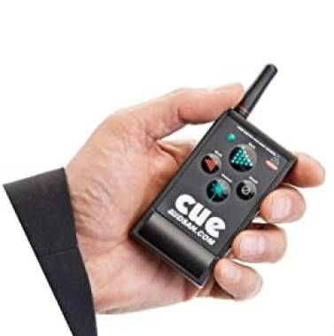
Information
Speaker Kits
- You will receive a wireless mic and a PPT pointer at the backstage.
- If you don’t want to use a wireless mic, then we will provide you with a handheld mic.
◼ Wireless Mic
◼ Handheld Mic
◼ PPT Pointer

Slide 9












Information
Dress Code
- Please wear business casual in a solid color combination. Below images are just an example.
Shirt
Gray or white
polo shirts
Suit Color
Beige with navy or
light gray with white
Shoes
Black or brown
dress shoes

Slide 10
Tech Session

Slide 11
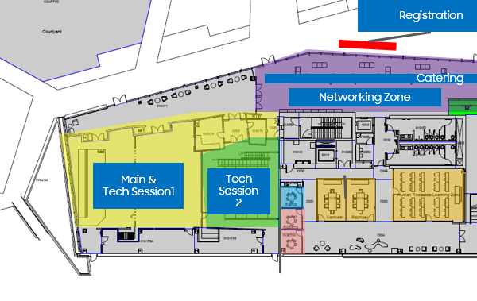
Tech Session
Speakers should arrive at least 15 minutes beforehand at the assigned Tech Session room for the pre-meeting with Session Chair.
The MC will introduce each speaker at the beginning of the session.
The presentations have a duration of 15 minutes. The timekeeper will inform you 3 minutes and 1 minute before the end.

Slide 12
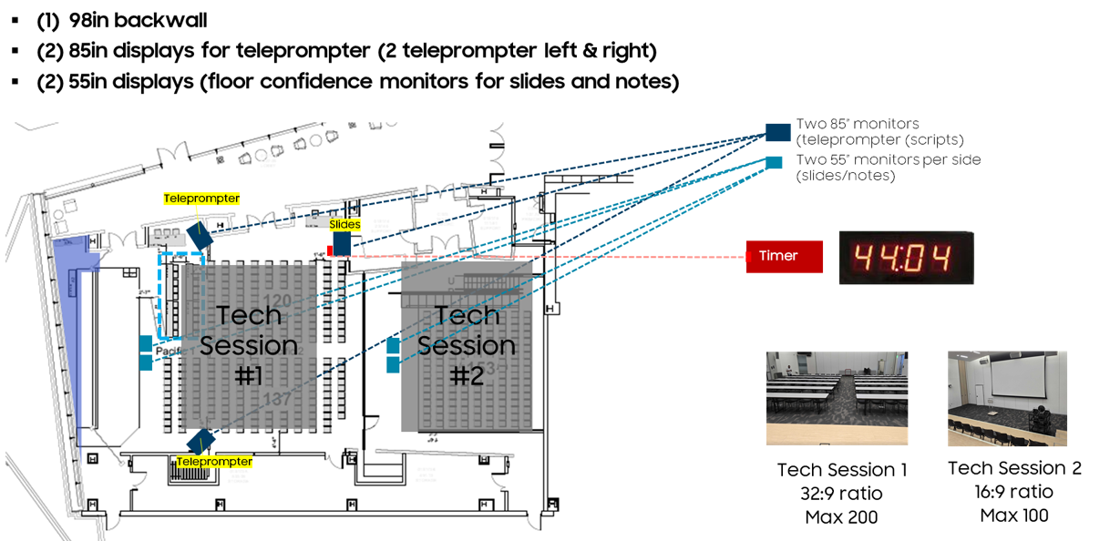
Tech Session
Prompter Guide
For Tech Session I, you will find three monitors in the room – one for presentation slide and two for teleprompters to show script.
For Tech Session II, you will find two monitors in the room – one for presentation slide and one for teleprompter to show script.
The script will be shown from top to bottom and vice versa. The speed of the prompter can be adjusted depending on the speed of speech.
The prompter will be shown with Teleprompter program.
During rehearsal, speakers can adjust the prompter speed and font size and decide whether to use the timer on the screen or not.
* If you would like to use a prompter, please send the script to us at least one week before the rehearsal date.

Slide 13
Tech Session I
Agenda
Tech Session I: Design Solutions for Silicon Intelligence
Time (PDT) | Duration | Presentation Title | Speaker
1:15 - 1:30 PM | 15 min. | Samsung Tech Talk | Ben Rhew (Samsung)
1:30 - 1:45 PM | 15 min. | ​The Learning on Building UCIe and Interposer | Alphawave
1:45 - 2:00 PM | 15 min. | Scalable Chiplet System Design with UCIe Advanced D2D Interface and Advanced Package Technology | Rebellions
2:00 - 2:15 PM | 15 min. | Pushing AI Chips Forward — Powered by Readiness and Relentless Innovation | SEMIFIVE
2:15 - 2:30 PM | 15 min. | Generative AI-Driven Newer and Faster IP Standards | Synopsys
2:30 - 2:45 PM | 15 min. | Enabling GenAI at the Edge | Ambarella
2:45 - 3:00 PM | 15 min. | Discover Next Generation AI/HPC SoC Design | GAONCHIPS
3:00 - 3:15 PM | 15 min. | Redefining SoC Design: The Shift to Chiplet-Based Architectures | Cadence
3:15 - 3:20 PM | 5 min. | Closing | Ben Rhew (Samsung)

Slide 14
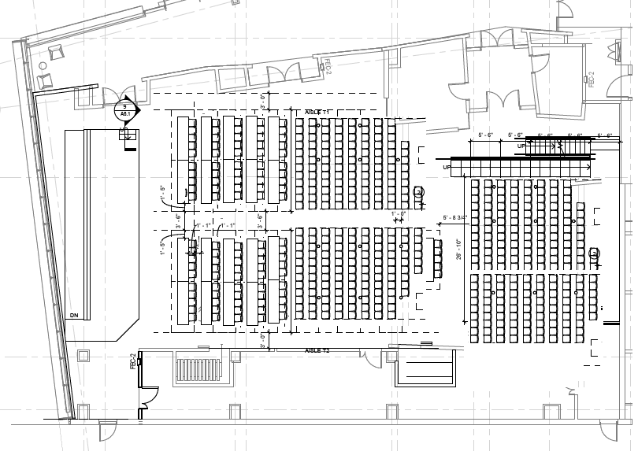
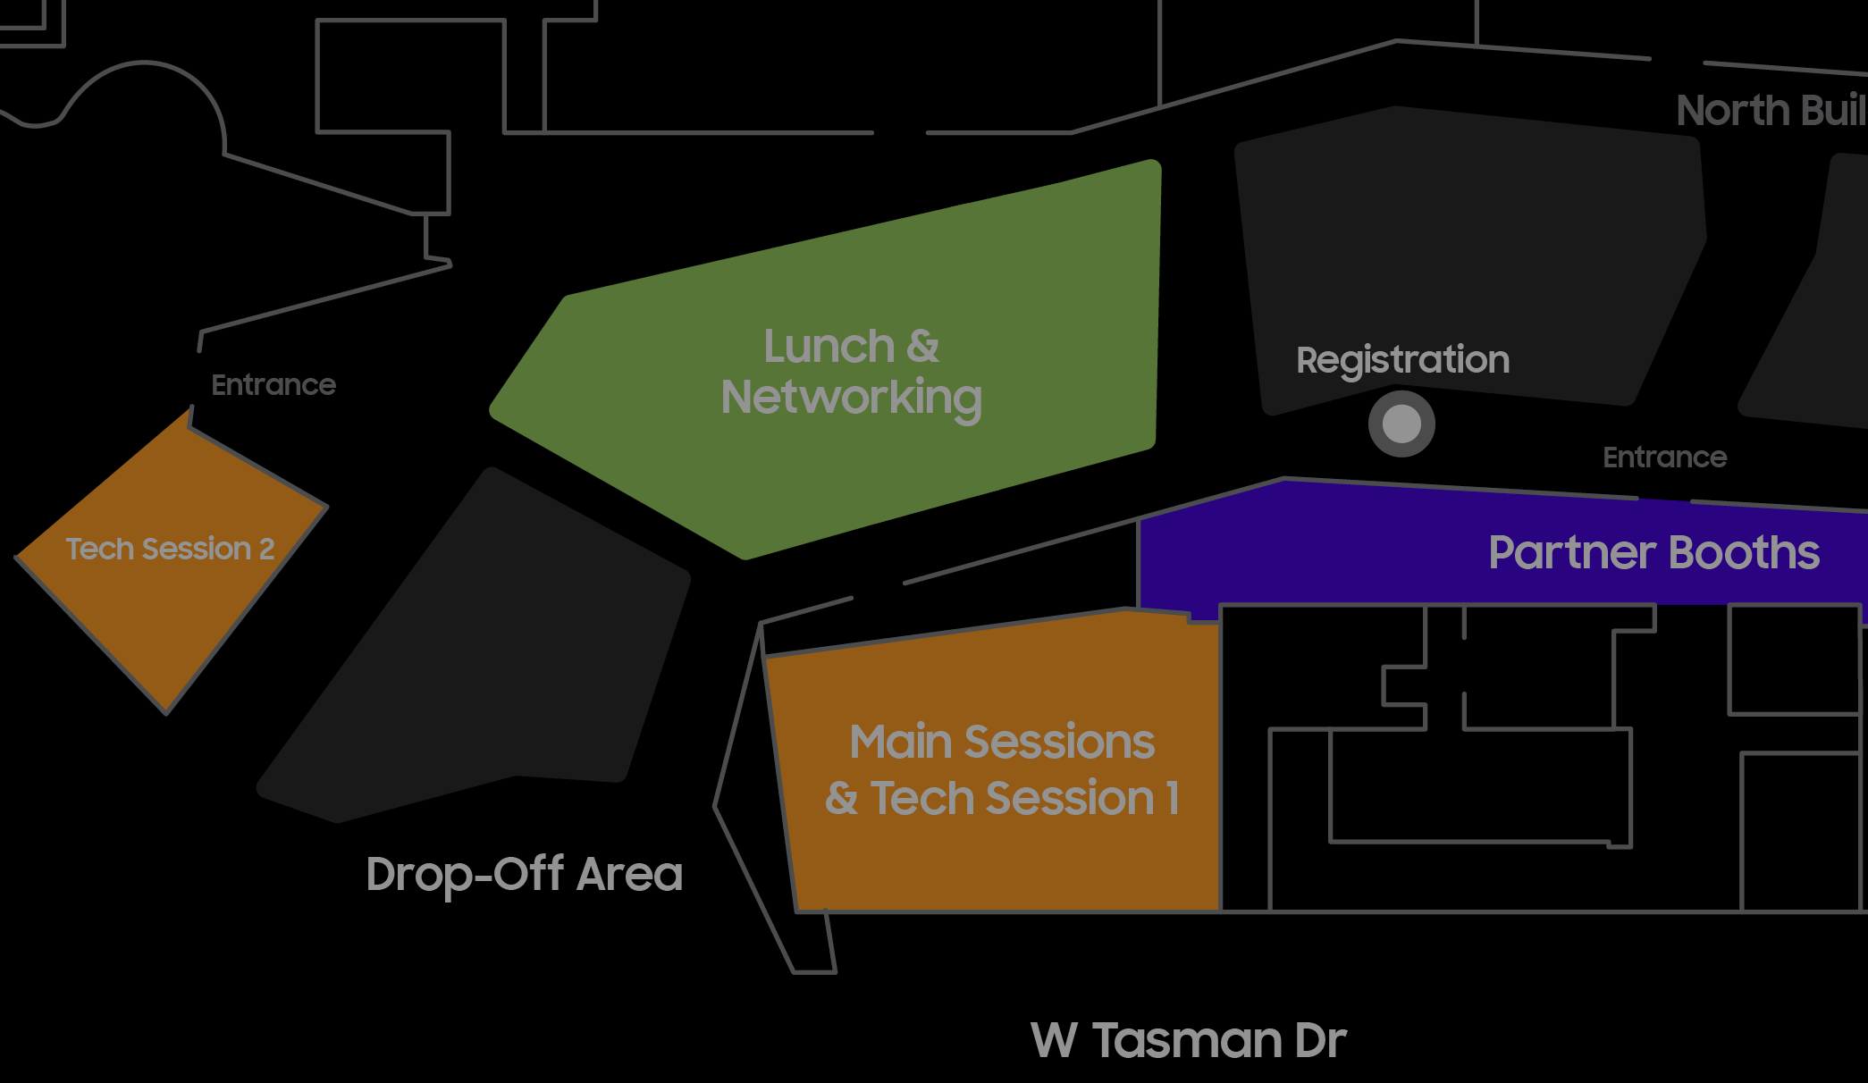
Tech Session I
Backstage Plan (Tech Session I)
① Please arrive at the main hall 15 minutes before the session.
② Please wait for the staff's instructions at the speaker's seat on the right side of the hall.
③ Go to the waiting area next to the stage before the presentation and wear the mic (headset mics).
④ The MC will call you onto the stage when it is your turn to speak.
⑤ After the presentation, please return to the speaker's seat.
4
Plenary
Session
2
3
1
10 min before speech, move to the backstage
2
Backstage: set up mic
3
Main stage: presentation
1
5
4
Backstage: remove mic
5
Return to assigned seat

Slide 15
Tech Session II
Agenda
Tech Session II: Design Enablement for Silicon Intelligence
Time (PDT) | Duration | Presentation Title | Speaker
1:15 - 1:30 PM | 15 min. | Samsung Tech Talk | Sungwook Moon (Samsung)
1:30 - 1:45 PM | 15 min. | SF2P Hyper Cell Flow Enhancements and PPA Benefits | Cadence
1:45 - 2:00 PM | 15 min. | Analog Node IP Migration Solution | Synopsys
2:00 - 2:15 PM | 15 min. | Innovative Design Reliability with Thermal/Stress Analysis for Samsung 3DIC LTV-F | Ansys
2:15 - 2:30 PM | 15 min. | Synopsys and Samsung Present Their Vision for Multi-Die Designs | Synopsys
2:30 - 2:45 PM | 15 min. | Providing Differentiated Solutions HPC and Ultra-Low Power Applications | ADTechnology
2:45 - 3:00 PM | 15 min. | Introduce of PKG Design Methodology to Reduce Turn-Around-Time for System in Package | CoAsia SEMI
3:00 - 3:15 PM | 15 min. | Siemens Unlocks the Potential of Silicon Photonics with Its Cutting-Edge Verification Platform, Powered by Samsung Foundry | Siemens
3:15 - 3:20 PM | 5 min. | Closing | Sungwook Moon (Samsung)

Slide 16
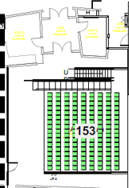
Tech Session II
Backstage Plan (Tech Session II)
① Please arrive at the main hall 15 minutes before the session.
② Please wait for the staff's instructions at the speaker's seat on the left side of the hall.
③ Go to the waiting space next to the stage before the presentation and wear the mic (headset mics).
④ The MC will call you upon the stage when it is your turn to speak.
⑤ After the presentation, please return to the speaker's seat.
1
10 min before speech, move to the side stage
2
Side stage: set up mic
3
Main stage: presentation
4
5
4
Side stage: remove mic
1
3
2
5
Return to assigned seat

Slide 17
Rehearsal

Slide 18
Rehearsal
Rehearsal Schedule
Date: Samsung will contact the speakers individually to arrange a rehearsal schedule
Location: Samsung Semiconductor U.S. Campus
Address: 3655 N. First St., San Jose, CA, 95134
※ Please contact Taeil Kim (ti1207.kim@samsung.com) if you have any questions about rehearsal.
Rehearsal Check Guide
Please ask the staff in the System Console for material revision
Check the main stage, where to enter and exit
Check the prompters in front of the stage, adjust them for speed and font size
Check sound
Check PPT material

Slide 19
Contact Info

Slide 20
Contact Info
Please contact us when you arrive at the rehearsal and the event site; we will escort you to the event hall.
Overall: Taeil Kim (ti1207.kim@samsung.com) Mobile: +82-10-9148-5160
Hanna Yang (hanna.yang@samsung.com) Mobile: +82-10-9348-0989
Don Kim (eastsky.kim@samsung.com) Mobile: +82-10-6218-3917
Tech Session I: Tony Luk (tony.luk@samsung.com) Mobile: 408-834-2658 (MC for Tech Session I)
MinKook Kim (mk1118.kim@samsung.com) Mobile: 408-592-9018
Taeil Kim (ti1207.kim@samsung.com) Mobile: +82-10-9148-5160
Tech Session II: Sudhir Koul (sudhir.koul@samsung.com) Mobile: 415-949-8675 (MC for Tech Session II)
MinKook Kim (mk1118.kim@samsung.com) Mobile: 408-592-9018
Taeil Kim (ti1207.kim@samsung.com) Mobile: +82-10-9148-5160

Slide 21
Thank You

